Slide 1


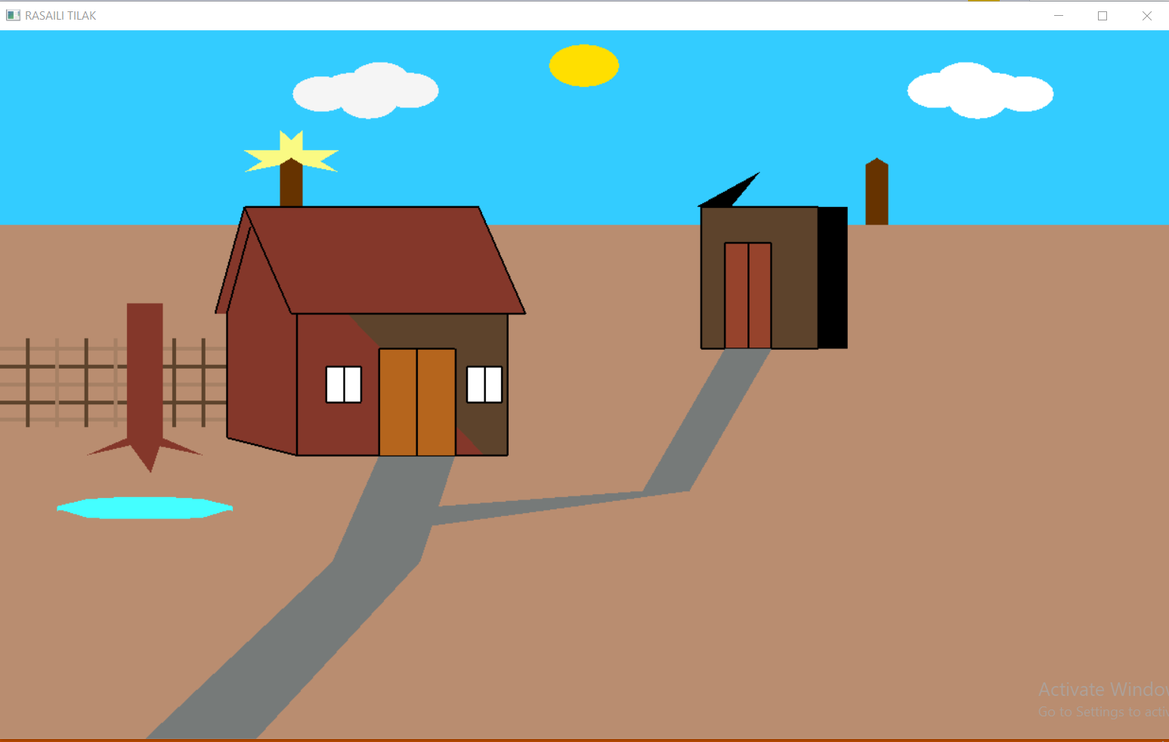
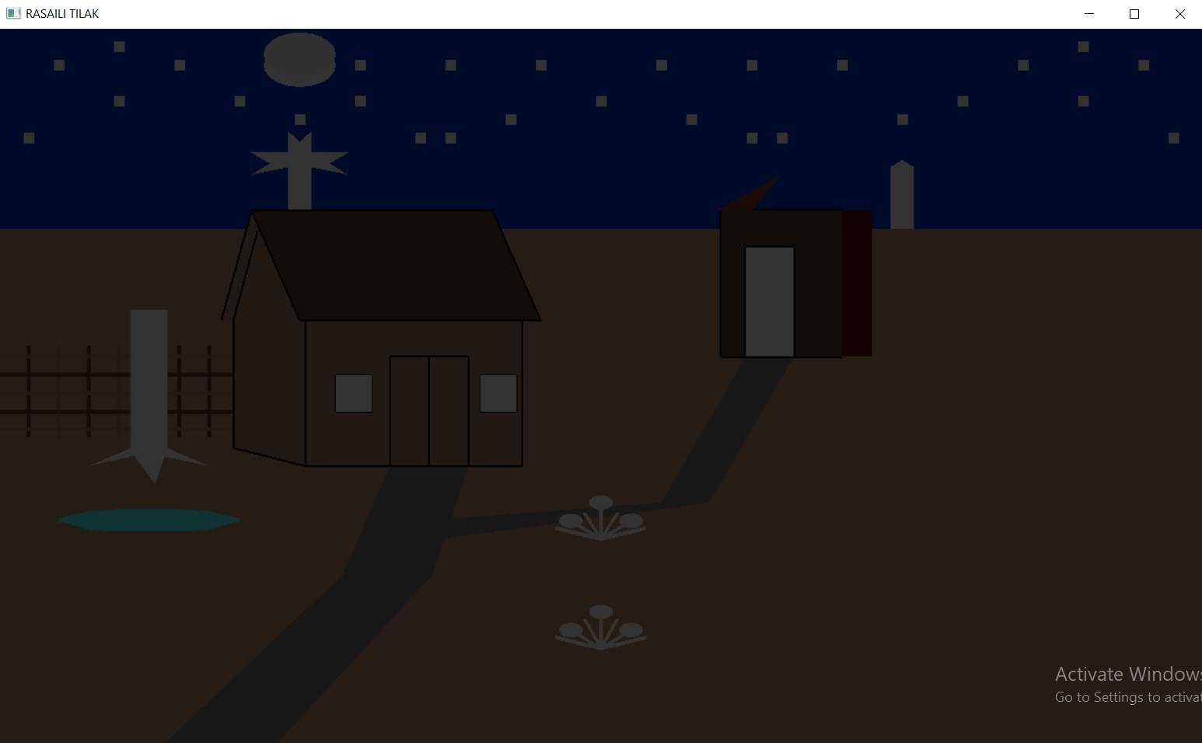
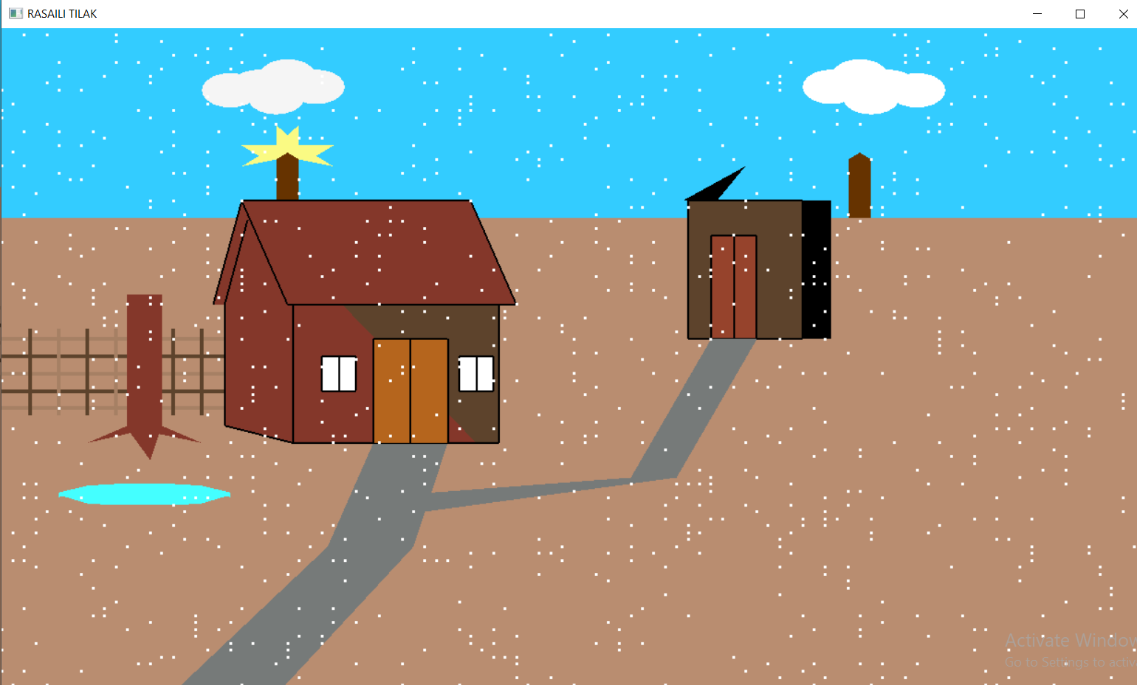
House in Desert Using Opengl
Rasaili Tilak, Nur Alam MD, Department of Smart
Computing, Kyungdong University, Republic of Korea.
Introduction
. This project done with visual studio C++(Opengl) to create 2d Picture and animation. Here is house in desert . We can change color and lighting effect on this project.
In day view we can see sun and all the environment bright. We can make rain on day time
at night time we can see small house door become white and big house color change into the desert sand color. Sunset at night time.
Simple animation is use here i.e. sunset, cloud move and rain at day time
Computer Graphics is concerned with all aspects of producing pictures or images using a computer. We can create images that are indistinguishable from photographs of real objects. In other terms, Computer Graphics are the graphics created by the computers, and more generally, the representation and manipulation of image data by a computer.
Output
  Day view
  Night view
Instruction:
Front display Student Information
Press “R” for snow.
Press “D” in Keyboard for day.
Press “N” in Keyboard for Night.
Discussion:
The proposed project is based on OPENGL program using c programing language. There are many functions and steps used to make this projects:
Header file
Define objects
Creating object
Adding colour on object, making position of object
Adding View state
Adding Lighting effects
Fig.1 Day view
Aim
The Aim of this project are given below:
To show the use of multi color in house. Which is located in desert area.
To show the uses of different geometric shape to create some real scene and picture.
To show lighting and shading effect applying day and night effect.
Fig.2 Night view
Methods:
Header Files:
Functions used:
Conclusion
This mini project on desert environment with simple house and surrounding environment. user-friendly interface allows the user to interact with it very effectively. User can change lighting effect and color of the house. In this project we use geometric 2d shape and animation i.e. movement of cloud and rain fall and sunset.
#include <GL/glut.h>
#include <string.h>
#include <stdio.h>
#include <stdlib.h>
#include <math.h>
#include <time.h>
Rain
glutInit()
glutInitDisplayMode()
glutInit()
glutInitDisplayMode()
glutCreateWindow()
glutInitWindowSize()
glutInitWindowPosition()
glutKeyboardFunc()
glutSpecialFunc()
glutReshapeFunc()
glRotatef()
glutIdleFunc()
glutDisplayFunc()
glutMainLoop()
glViewport()
glVertex3fv()
glColor3fv()
glFlush()
glutPostRedisplay()
glMatrixMode()
glLoadIdentity()
glTranslatef() :
Fig.3 Night view
The snapshot above shows a short description about the project.
Acknowledgements
This study was carried out with the academic project under computer graphics, Department of Smart Computing, Kyungdong University (KDU), Republic of Korea.

